Slide 1


30 Days DATABASE MANAGEMENT SYSTEM Master Class
Hand Book
30 Days Database Management System Master Class

Slide 2

What is Master Class?
👍 This is the 30 Days Industrial Learning Activity.
👍 Its Online YouTube Live Class
👍 If you Invest 45 minutes daily, U will become a Master in DATABASE MANAGEMENT SYSTEM
👍You will get E-Certificate
Participation Certificate
“Learning is the beginning of wealth.
Searching & Learning is where the miracle process all begins.” …………….Jim Rohn
30 Days Database Management System Master Class

Slide 3
Pantech?
Educational Equipment Manufacturer
IoT, AI, Robotics,Autonomous Robot
Microprocessor/Microcontroller
DSP,VLSI, Embedded System
Power Electronics & Drives, Fuel Cell Trainer Kit
Renewable Energy Lab, Electric Vehicle Lab
Technical Training
DIY Project
30 Days Database Management System Master Class

Slide 4
Our Vision
Help 10 Million Students to Learn the Technology in Easy Way
30 Days Database Management System Master Class

Slide 5
What U will Learn from 30 Days DATABASE MANAGEMENT SYSTEM Master Class
30 Days Database Management System Master Class
www.pantechelearning.com 30 Days Python Full Stack Master Class

Slide 6

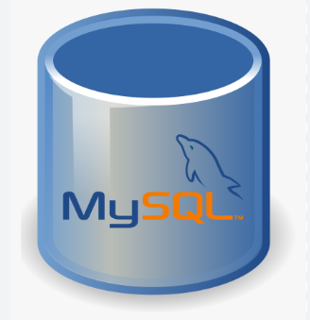
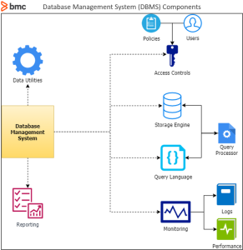

DBMS Learning Plan
01
02
03
04
DBMS TOOLS
Mongo DB
SQL - Query
PROJECTS
30 Days Database Management System Master Class
www.pantechelearning.com 30 Days Python Full Stack Master Class

Slide 7
Day wise Learning Plan
DAY 1 - DBMS Overview , DBMS Architecture , Data Models DAY 2 - DBMS – Data Schemas , Data independence
DAY 3 - DBMS – ER Model Basic Concepts , ER Diagram Representation , Generalization Aggregation DAY 4 - Codd’s Rules , Relational Data Model , Relational Algebra DAY 5 - DBMS – ER to Relational Model , SQL Overview
DAY 6 - Database Normalization , Database Joins DAY 7 - Storage System , File Structure DAY 8 - Indexing , Hashing DAY 9 - Transaction , Concurrency Control , DeadLock DAY 10 - Data Backup , Data Recovery DAY 11 - Overview , RDBMS Concepts , Databases DAY 12 - Syntax , DataTypes , Operators DAY 13 - Expressions , Create Database , Drop Database
DAY 14 - Select Database , Rename Database , Show Database
DAY 15 - Create Table , Show Tables , Rename Table
30 Days Database Management System Master Class
www.pantechelearning.com 30 Days Python Full Stack Master Class

Slide 8
Day wise Learning Plan
DAY 16 - Truncate Tables , Clone Tables , Temporary Tables
DAY 17 - Alter Table , Drop Table , Delete Table , Constraints DAY 18 - Insert Query , Select Query , Update Query
DAY 19 - Delete Query , Constraints DAY 20 - Delete Query , Constraints DAY 21 - MongoDB - Overview , Advantages , Data Modelling DAY 22 - MongoDB – Create Database , Drop Database , Create Collection DAY 23 - Drop Collection , Data Types DAY 24 - Insert Document , Query Document , Update Document DAY 25 - Delete Document , Projection , Limiting Records , Sorting Records DAY 26 - Indexing , Aggregation , Replication , Sharding DAY 27 - Create Backup , Deployment , Java
DAY 28 - MongoDB – Project Example DAY 29 - MongoDB – Project Example
DAY 30 - MongoDB – Project Example
30 Days Database Management System Master Class
www.pantechelearning.com 30 Days Python Full Stack Master Class

Slide 9
What you will get from this Free 30 Days Master Class?
You can attend YouTube Live Class
E-Certificate ( PARTICIPATION CERTIFICATE)
30 Days Database Management System Master Class

Slide 10
How to mark your Attendance in YouTube Live Class?
Ans : During the Live Class, organizer will post Google Form link in Live Chat. The Participants should submit the from on daily basis. Minimum 25 Days Attendance is Required to get Master Class Participation Certificate.
Note : The Link will be available during the Live. From the LIVE Class date, the live video will get removed from the YouTube in 3 days.
30 Days Database Management System Master Class
www.pantechelearning.com 30 Days Python Full Stack Master Class

Slide 11
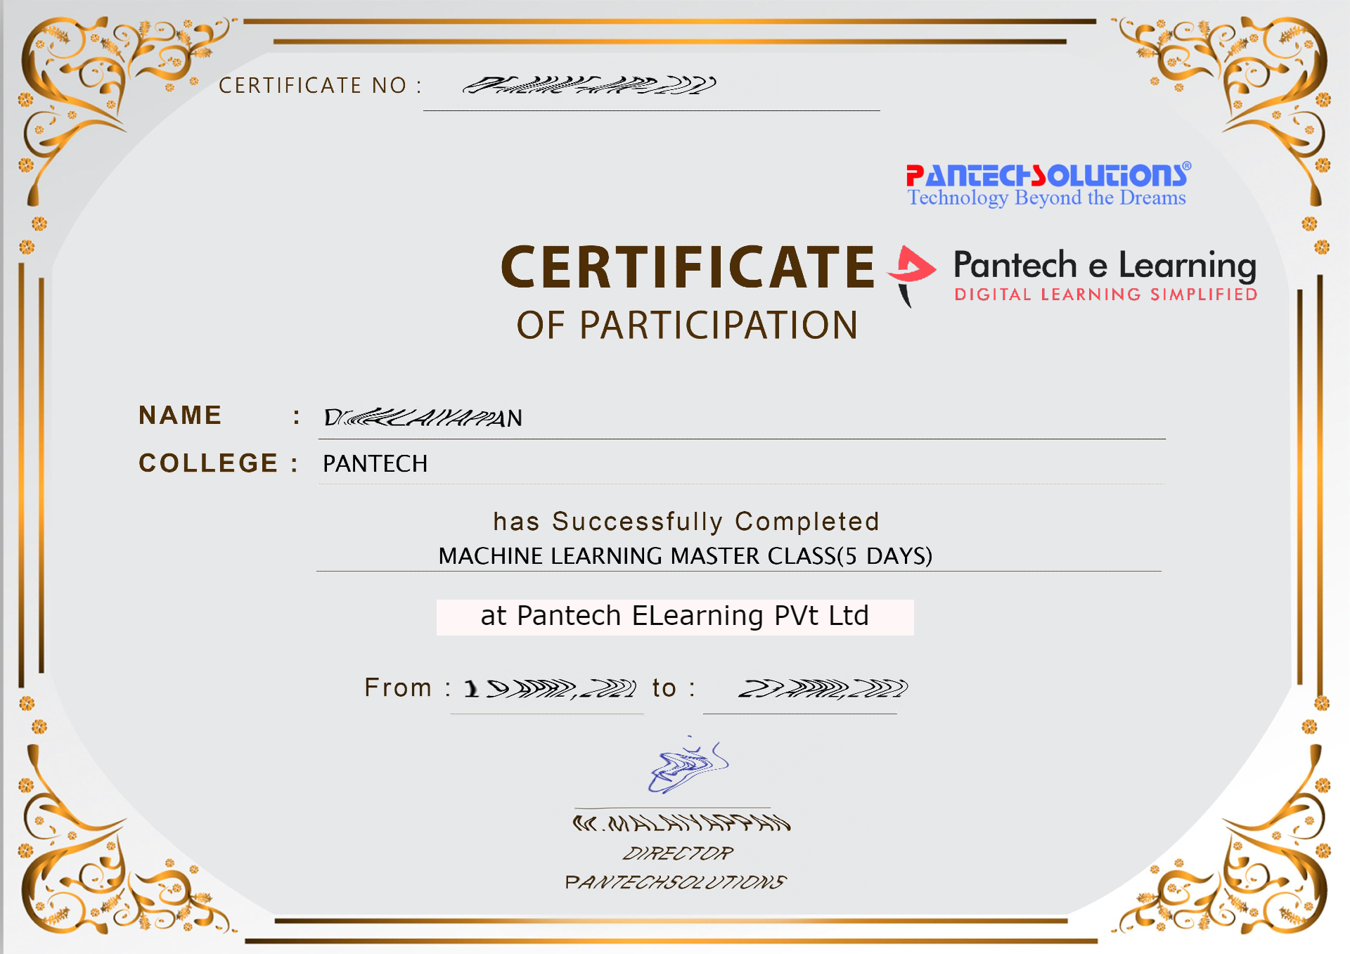

Sample Webinar Participation Certificate?
30 Days Database Management System Master Class
www.pantechelearning.com 30 Days Python Full Stack Master Class

Slide 12
Pantech will make you to Create 7 Projects in DATABASE MANAGEMENT SYSTEM in 30 Days
Objective of this 30 Days Master Class
30 Days Database Management System Master Class
www.pantechelearning.com 30 Days Python Full Stack Master Class

Slide 13
What You Will Get???
Project Files of DBMS IDE
30 Days Learning Activity
DBMS concepts
Projects
Project PPT
Video Class Access for 3 Months
Get chance to Enroll 1-Month Internship on demand
30 Days Database Management System Master Class
www.pantechelearning.com 30 Days Python Full Stack Master Class

Slide 14
You can convert this MASTERCLASS into a CERTIFIED INTERNSHIP
30 DAYS OF LIVE + RECORDED SESSIONS
30 DAYS OF PRESENTATION FOR DOWNLOAD
7+ PROJECT SOURCE CODES For DOWNLOAD
1 MONTH INTERNSHIP CERTIFICATE
PARTICIPATION CERTIFICATE
90 DAYS OF ACCESS TO COURSES
5 HACKATHON LIVE SESSIONS
COMMUNITY GROUP
30 Days Database Management System Master Class
www.pantechelearning.com 30 Days Python Full Stack Master Class

Slide 15
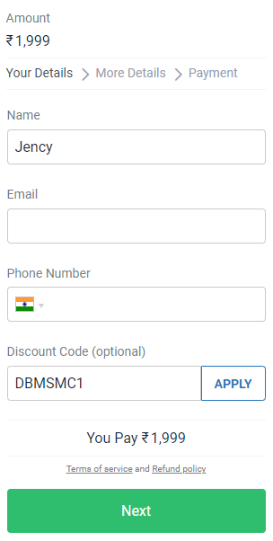
1 MONTH INTERNSHIP
https://imjo.in/6tKYGc
FEE : rs.1999
COUPON DISCOUNT : Rs.999
FEE : Rs.999
COUPON : DBMSMC1
30 Days Database Management System Master Class
www.pantechelearning.com 30 Days Python Full Stack Master Class

Slide 16

1 month internship on python programming
Reg Link - https://imjo.in/6tKYGc
FEE : Rs.999
COUPON : DBMSMC1
30 Days Database Management System Master Class
www.pantechelearning.com 30 Days Python Full Stack Master Class

Slide 17
Learn the complete CONCEPTS on DATABASE MANAGEMENT SYSTEM .. With Practice & Implementation
30 Days Database Management System Master Class

Slide 18

Happy learning
Call / WhatsApp:
+91 89255 33484
+91 8925533488
30 Days Database Management System Master Class
www.pantechelearning.com 30 Days Python Full Stack Master Class

